Slide 1
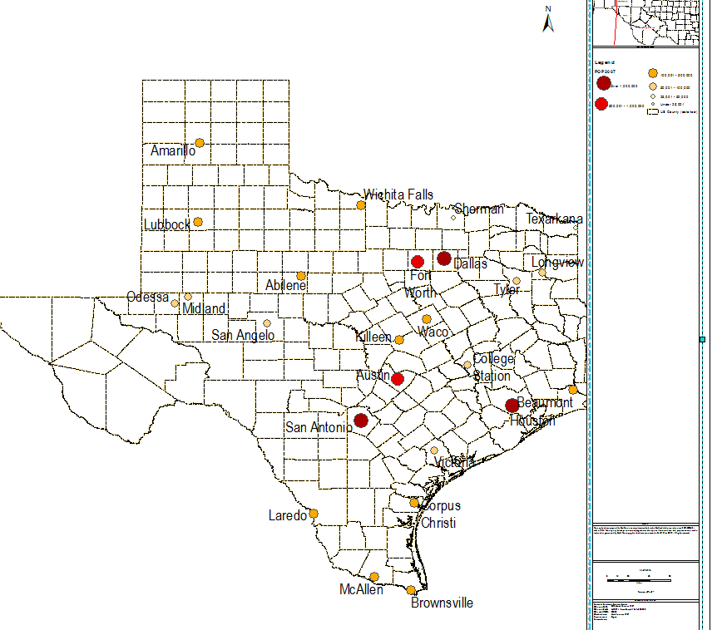

Slide 3
TEXAS BLS MAY 2018
Filter Settings
- TOT_EMP: (30 <= TOT_EMP <= 3568180) without empty values
- Date: (5/1/2018)

Slide 4
TEXAS BLS MAY 2018 TOAL EMPLOYMENT MAJOR CATEGORY ALL AREAS
Filter Settings
- OCC_GROUP: (major)

Slide 5
Filter Settings
- Date: (5/1/2018)
- AREA_NAME: (Austin-Round Rock, TX, Dallas-Fort Worth-Arlington, TX, Dallas-Plano-Irving, TX Metropolitan Division, Fort Worth-Arlington, TX Metropolitan Division, Houston-The Woodlands-Sugar Land, TX, San Antonio-New Braunfels, TX)
- OCC_GROUP: (major)

Slide 6
TEXAS BLS MAY 2018 MANAGEMENT OCCUPATIONS BY AREA
Filter Settings
- OCC_CODE: (11-1011, 11-1021, 11-1031, 11-2011, 11-2021, 11-2022, 11-2031, 11-3011, 11-3021, 11-3031, 11-3051, 11-3061, 11-3071, 11-3111, 11-3121, 11-3131, 11-9013, 11-9021, 11-9031, 11-9032, 11-9033, 11-9039, 11-9041, 11-9051, 11-9061, 11-9081, 11-9111, 11-9121, 11-9131, 11-9141, 11-9151, 11-9161, 11-9199)

Slide 7
TEXAS BLS MAY 2018 BY MAJOR OCCUPATION PER AREA
Filter Settings
- Date: (5/1/2018)
- OCC_GROUP: (major)

Slide 8
TEXAS BLS MAY 2017 BY MAJOR OCCUPATION PER AREA
Filter Settings
- Date: (5/1/2017)
- OCC_GROUP: (major)

Slide 9
TEXAS BLS MAY 2016 BY MAJOR OCCUPATION PER AREA
Filter Settings
- Date: (5/1/2016)
- OCC_GROUP: (major)

Slide 10
TEXAS BLS MAY 2018 COMPUTER AND MATH BY DETAILED OCCUPATION PER AREA
Filter Settings
- Date: (5/1/2018)
- OCC_CODE: (15-1111, 15-1121, 15-1122, 15-1131, 15-1132, 15-1133, 15-1134, 15-1141, 15-1142, 15-1143, 15-1151, 15-1152, 15-1199, 15-2011, 15-2031, 15-2041, 15-2090)

Slide 11
TEXAS BLS MAY 2016 - 2018 COMPUTER AND MATH BY DETAILED OCCUPATION PER AREA
Filter Settings
- Date: (5/1/2016, 5/1/2017, 5/1/2018)
- OCC_CODE: (15-1111, 15-1121, 15-1122, 15-1131, 15-1132, 15-1133, 15-1134, 15-1141, 15-1142, 15-1143, 15-1151, 15-1152, 15-1199, 15-2011, 15-2031, 15-2041, 15-2090)

Slide 12
TEXAS BLS MAY 2016 - 2018 CONSTRUCTION AND EXTRACT DETAILED OCCUPATION PER AREA
Filter Settings
- Date: (5/1/2016, 5/1/2017, 5/1/2018)
- OCC_CODE: (47-1011, 47-2011, 47-2021, 47-2022, 47-2031, 47-2041, 47-2042, 47-2043, 47-2044, 47-2051, 47-2053, 47-2061, 47-2071, 47-2072, 47-2073, 47-2081, 47-2111, 47-2121, 47-2131, 47-2132, 47-2141, 47-2151, 47-2152, 47-2161, 47-2171, 47-2181, 47-2211, 47-2221, 47-3011, 47-3012, 47-3013, 47-3014, 47-3015, 47-3016, 47-3019, 47-4011, 47-4021, 47-4031, 47-4041, 47-4051, 47-4061, 47-4071, 47-4090, 47-4099, 47-5011, 47-5012, 47-5013, 47-5021, 47-5031, 47-5041, 47-5042, 47-5051, 47-5071, 47-5081, 47-5099)

Slide 13
TEXAS BLS MAY 2016 - 2018 HEALTHCARE OCCUPATIONS BY DETAILED OCCUPATION PER AREA
Filter Settings
- OCC_CODE: (29-1011, 29-1021, 29-1022, 29-1023, 29-1029, 29-1031, 29-1041, 29-1051, 29-1061, 29-1062, 29-1063, 29-1064, 29-1065, 29-1066, 29-1067, 29-1069, 29-1071, 29-1081, 29-1122, 29-1123, 29-1124, 29-1125, 29-1126, 29-1127, 29-1128, 29-1129, 29-1131, 29-1141, 29-1151, 29-1161, 29-1171, 29-1181, 29-1199, 29-2010, 29-2011, 29-2012, 29-2021, 29-2031, 29-2032, 29-2033, 29-2034, 29-2035, 29-2041, 29-2051, 29-2052, 29-2053, 29-2054, 29-2055, 29-2056, 29-2057, 29-2061, 29-2071, 29-2081, 29-2091, 29-2092, 29-2099, 29-9011, 29-9012, 29-9091, 29-9092, 29-9099)

